Slide 1

Compiler Design
Preet Kanwal
Department of Computer Science & Engineering
Teaching Assistant : Kavya P K

Slide 2

Compiler Design
Unit 1
Design of a Lexical Analyzer Generator
Preet Kanwal
Department of Computer Science & Engineering

Slide 3
Compiler Design Lecture Overview
In this lecture, you will learn about:
Maximal Munch Rule
Questions
Lexical Analyzer with Lex
The Structure of the Lex Analyzer Generator
Constructing Automata - RE to NFA to DFA
Example - Constructing Automata
Lookahead Operator in Lex (/)
Program - To identify keywords and identifiers
Program - Demonstrate Maximal munch rule

Slide 4
Compiler Design
Behaviour of Lexer - Example 1
Given - abb aba
a
printf(“1”)
printf(“2”)
printf(“3”)
Questions:
Provide output for the String : a
Provide output for the String : ababa

Slide 5
Compiler Design
How does a Lexer resolve ambiguities?
Lex follows the principle of Maximal Munch rule.
When more than one pattern can match the input, lex chooses as follows:
The longest match is preferred.
Among rules that match the same number of characters, the rule that occurs earliest in the list is preferred.

Slide 6

Compiler Design Example 1 - Solution
Given - abb aba
a
printf(“1”)
printf(“2”)
printf(“3”)
Questions:
Provide output for the String : a
Answer - 3
Provide output for the String : ababa
Answer - 2b3
Recall Panic Mode Recovery
aba - 2
b
a - 3

Slide 7
Compiler Design Example 2
Given - a*b (a|b)*b c*
printf(“1”)
printf(“2”)
printf(“3”)
Questions:
Provide output for the String : cbabc
Provide output for the String : cbbbbac
Provide a String such that the Output is 132

Slide 8
Compiler Design Example 2 - Solution
a*b (a|b)*b c*
printf(“1”)
printf(“2”)
printf(“3”)
Provide output for the String : cbabc
Answer - 323
c - 3
bab - 2
c - 3
Provide output for the String : cbbbbac
Answer - 32a3
c - 3
bbbb - 2
a - a
c - 3
Provide a String such that the Output is 132
Answer - abccbb
ab - 1
cc - 3
bb - 2
Other answers are possible

Slide 9
Compiler Design Example 3
Given - aa b?a+b?
b?a*b?
printf(“1”)
printf(“2”)
printf(“3”)
Questions:
Provide output for the String : bbbaabb
Provide a String such that the Output is 123
Provide a String such that the Output is 321

Slide 10
Compiler Design Example 3 - Solution
aa b?a+b?
b?a*b?
printf(“1”)
printf(“2”)
printf(“3”)
Provide output for the String : bbbaabb
Answer - 323
bb - 3
baab - 2
b - 3
Provide a String such that the Output is 123
Not possible
Provide a String such that the Output is 321
bbbabaa
bb - 3
bab - 2
aa – 1
Other answers are possible

Slide 11
Compiler Design Example 4
Give an Example of such a set of regular expressions and an input string such that :
The String can be broken apart into substrings, where each substring matches one of the regular expressions BUT,
The longest-prefix algorithm will fail to break the string in a way where each piece matches one of the regex.

Slide 12
Compiler Design Example 4 - Solution
Answer -
Suppose the patterns are as follows :
a* ab bb
print(“1”)
print(“2”)
print(“3”)
Let the pattern be aabbb
Here, a matches 1, ab matches 2 and bb matches 3
However, due to maximal munch rule, the longest match is found, and
aa matches 1, bb matches 3 and last b is left unmatched. So output is 13b

Slide 13
Compiler Design
Verify the answers of the Example 1,2,3,4 using lex
Program Files -
Example 1 - example1.l
Example 2 - example2.l
Example 3 - example3.l
Example 4 - example4.l
In this program, lex shows a warning - “rule cannot be matched”, because the first rule always matches the lexemes matched by the other 2 rules.

Slide 14
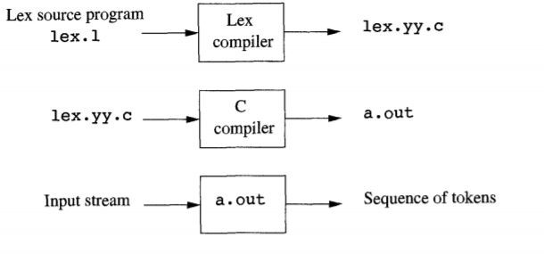
Compiler Design
Lexical Analyzer with Lex

Slide 15
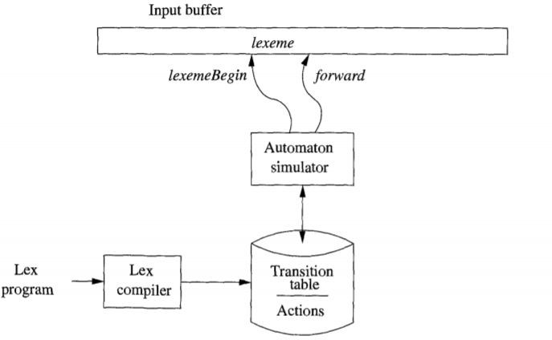
Compiler Design
The Structure of the Lex Analyzer Generator

Slide 16
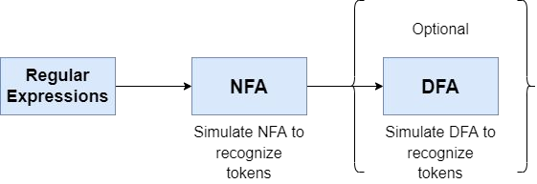
Compiler Design
Constructing Automata - RE to NFA to DFA

Slide 17
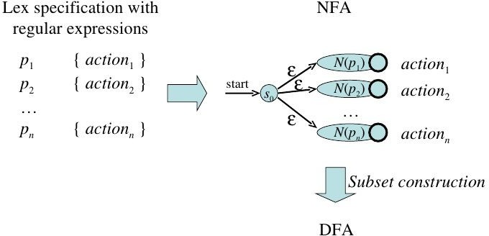
Compiler Design
Constructing Automata - RE to NFA to DFA
Convert each pattern (regular expressions) in the lex program to an NFA.
Combine all NFAs into one using a new start state, with ε transactions to each of the start states of the NFAs.
Convert the combined NFA to DFA.

Slide 18
Compiler Design
The Structure of the Lex Analyzer Generator
The generated lexical analyzer consists of components that are created from the lex specification file.
These components are -
Transition Table - Created for all patterns defined in the lex program.
Actions - Fragments of code defined to their corresponding patterns.
Actions are invoked by the Automata Simulator at the appropriate time.
Functions - Defined in the auxiliary functions section of the lex program, these are passed directly through lex to the output file.
Automata Simulator - The program that serves as the lexical analyzer and uses the components mentioned above.
It simulates an automata (NFA or DFA)

Slide 19
Compiler Design
Question 1- Construct an automata for the lex program
Given patterns and corresponding actions -
a abb a*b+
A1 A2 A3

Slide 20
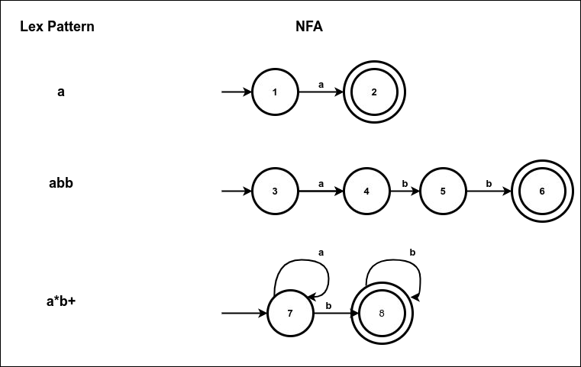
Compiler Design
Question 1- Construct an automata for the lex program
Step 1 - Convert each lex pattern to an NFA

Slide 21
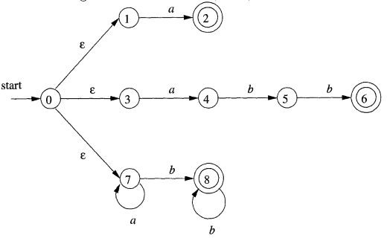
Compiler Design
Question 1- Construct an automata for the lex program
Step 2 - Construct a combined NFA by adding a new start state, and ε
transactions to each start state (1,3,7)

Slide 22
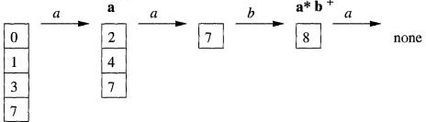
Compiler Design
Question 1- Construct an automata for the lex program
If the Lexical analyzer simulates the above NFA, pattern matching is done as follows -
Let the input lexeme be aaba
Initially, the combined NFA reads the input character pointed by lexeme_begin.
The forward pointer moves ahead. Set of states is calculated at each point.
When the NFA simulation reaches a point in the input where there are no next states, the set of states is empty (none).
Sequence of states entered while processing input aaba

Slide 23
Compiler Design
Question 1- Construct an automata for the lex program
At this point, the longest prefix that matches the NFA can be identified,
As indicated in the diagram, in state 8, aab matches the pattern a*b.
Prefix aab is the longest prefix, and so it executes action A3.
The forward pointer is moves to the end of the lexeme.
Note - If there are several accepting states in the set, the action associated with the earliest pattern is executed.
Sequence of states entered while processing input aaba

Slide 24
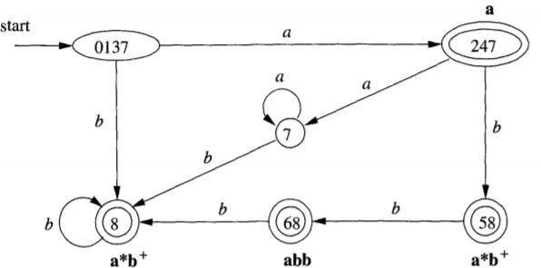
Compiler Design
Question 1- Construct an automata for the lex program
Step 3 - Convert NFA to DFA

Slide 25
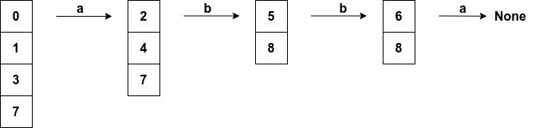
Compiler Design
Question 1- Construct an automata for the lex program
If the Lexical analyzer simulates the above DFA, pattern matching is done as follows -
Let the input lexeme be abba
Set of states is calculated at each point.
When the DFA simulation reaches a point in the input where there are no next states, the action associated with the last accepting state is executed.
The lexeme is abb, and the accepting state is 68
This matches pattern abb, and action A2 is executed
Sequence of states entered while processing input abba

Slide 26
Compiler Design
Question 2- Construct an automata for the lex program
Given patterns and corresponding actions -
a*b (a|b)*b c*
A1 A2 A3

Slide 27
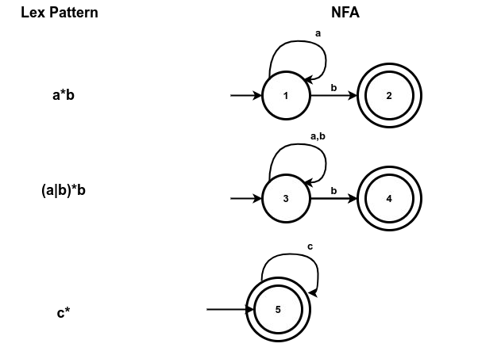
Compiler Design
Question 2- Construct an automata for the lex program
Step 1 - Convert each lex pattern to an NFA

Slide 28
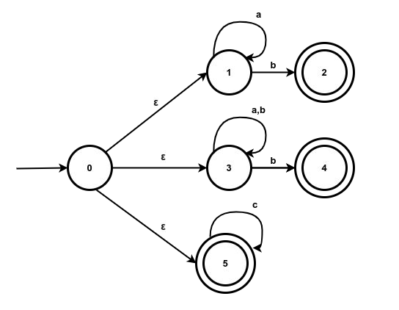
Compiler Design
Question 2- Construct an automata for the lex program
Step 2 - Construct a combined NFA by adding a new start state, and ε
transactions to each start state (1,3,5)

Slide 29
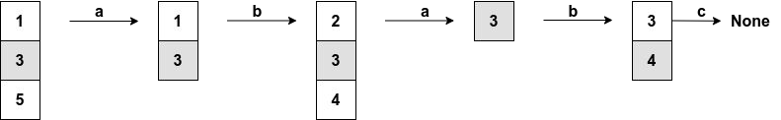
Compiler Design
Question 1- Construct an automata for the lex program
If the Lexical analyzer simulates the above NFA, pattern matching is done as follows -
Let the input lexeme be ababc
Initially, the combined NFA reads the input character pointed by lexeme_begin.
The forward pointer moves ahead. Set of states is calculated at each point.
When the NFA simulation reaches a point in the input where there are no next states, the set of states is empty (none).
Sequence of states entered while processing input ababc

Slide 30
Compiler Design
Question 1- Construct an automata for the lex program
At this point, the longest prefix that matches the NFA can be identified,
As indicated in the diagram, in state 8, abab matches the pattern (a|b)*b.
Prefix abab is the longest prefix, and so it executes action A2.
The forward pointer is movies to the end of the lexeme.
Note - If there are several accepting states in the set, the action associated with the earliest pattern is executed.
Sequence of states entered while processing input aabac

Slide 31
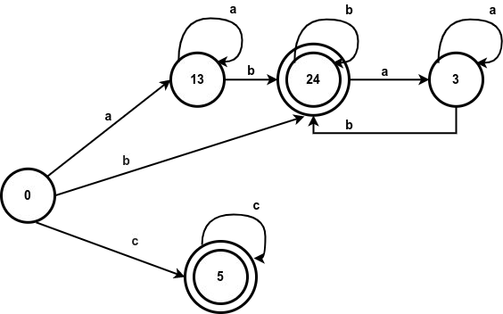
Compiler Design
Question 1- Construct an automata for the lex program
Step 3 - Convert NFA to DFA

Slide 32
Compiler Design
Question 1- Construct an automata for the lex program
If the Lexical analyzer simulates the above DFA, pattern matching is done as follows -
Let the input lexeme be ababc
Set of states is calculated at each point.
When the DFA simulation reaches a point in the input where there are no next states, the action associated with the last accepting state is executed.
The lexeme is abab, and the accepting state is 24
This matches pattern (a|b)*b, and action A2 is executed
Sequence of states entered while processing input ababc

Slide 33
Compiler Design
Lookahead Operator in Lex (/)
When a certain pattern is required to be matched only when it is followed by certain other characters, the lookahead operator is / used
r1 / r2
r1 - the pattern that matches the lexeme
r2 - the additional pattern that must be matched before deciding the token of the lexeme. Note - the characters that match r2 is NOT part of the lexeme.
Example - FORTRAN IF statement of the from IF(condition) THEN …
In FORTRAN, keywords are not reserved

Slide 34
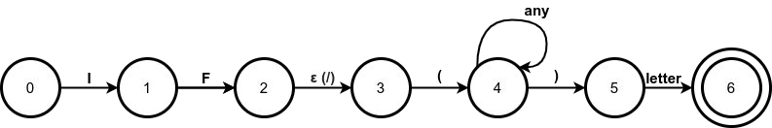
Compiler Design
Implementation of Lookahead Operator
When converting to NFA, the lookahead operator (/) is treated as an ε
transaction.
The below diagram represents NFA for FORTRAN IF using lookahead
The ε transaction from state 2 to state 3 represents the lookahead operator.
State 6 indicates presence of IF
The lexeme IF is found by scanning backwards to the last occurrence of state 2 whenever state 6 is reached.
Note - If the NFA has more than one ε transaction on / , then the problem of finding the correct state (e.g, state 2 in this example) is difficult.

Slide 35
Compiler Design
Lookahead Operator in Lex (/)
IF is always followed by
Left parenthesis (
Some text
Right parenthesis )
Any letter
The lex rule can be written as IF/\(.*\){letter}
This lex code demonstrates use of / to detect a FORTRAN IF
letter [A-Za-z]
%{
#include<stdio.h>
%}
%%
IF/\(.*\){letter} printf("FORTRAN IF");
. ;
%%
int yywrap(){return(1);} int main()
{
yyin = fopen("input.txt", "r"); yylex();
fclose(yyin); return 0;
}
Program file : lookahead.l

Slide 36
Compiler Design
Write the lex file to identify identifiers and keywords
digit [0-9] letter [A-Za-z]
%{
#include <stdio.h>
}%
%%
if|else|int|char|float {printf("Keyword :\t %s",yytext);
{letter}({letter}|{digit})* printf("Valid Identifier:\t %s",yytext);
. ;
%%
int yywrap(){return(1);} int main() {
yyin = fopen(“input.txt”, "r"); yylex();
fclose(yyin);
}
The rule
. ;
is used to ignore all other characters.
Program file : keywords_and_identifiers.l

Slide 37
THANK YOU
Preet Kanwal
Department of Computer Science & Engineering
preetkanwal@pes.edu

